Slide 1
Valida: EMIS
Multiple CDBs
Access Guide for Clinical and Clerical Users without Smartcards

Slide 2


Background & Context
A number of organisations, particularly Community Providers, use multiple instances of EMIS. Each instance has a different “CDB” (Clinical DataBase) number
The Valida client ensures users have a legitimate relationship with the patient (they can see the patient’s record in EMIS). This saves duplication of data entry and ensures relevant data added to a UCP outside of the originating organisation is added to patient records where appropriate.
When starting the Valida Client, the user needs to select in the Valida Client which instance of EMIS they have open (or are going to be opening).

Slide 3

Getting Started
Find the Valida icon on your desktop and double click to get the application to start. After this first time, the Valida client will start automatically when the machine is restarted.
UCP Valida Support Line

Slide 4
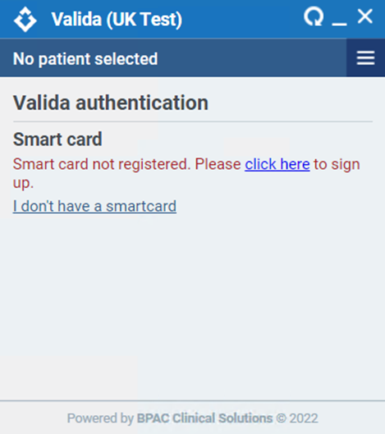
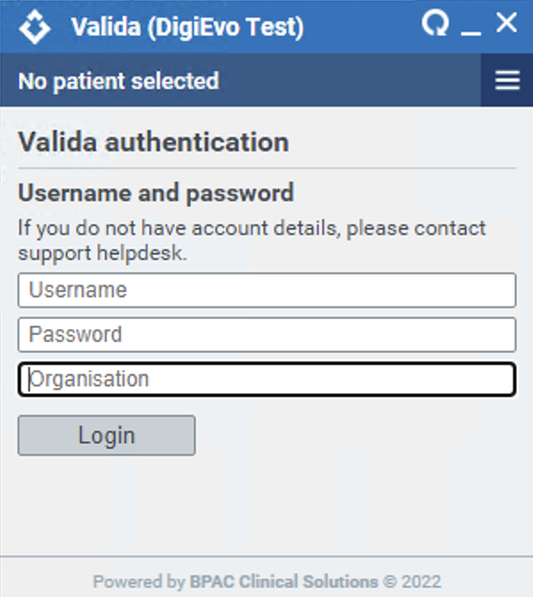
Access Valida Client
Upon launching the Valida client, the following screen will appear:
Click on “I don’t have a Smartcard” link
Enter the username and password (this will have been provided to you) plus your Organisation’s code – this will be provided on the email sent to users.
To set up new users complete the below spreadsheet
UCP Valida Support Line

Slide 5
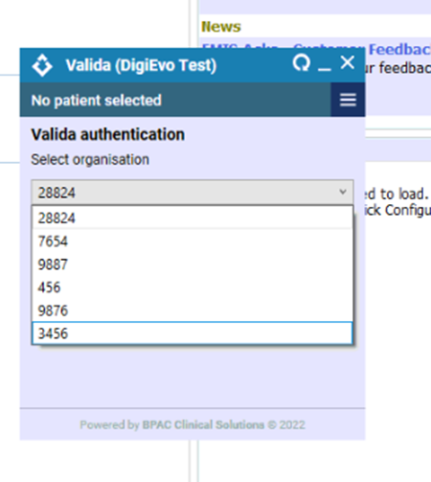
Access Valida Client 2
If you organisation has more than one CDB you will see this dropdown:
Select the same CDB as you currently have open in EMIS (or want to open in EMIS).
When you want to swap between different EMIS CDBs, please close and reopen the Valida Client.
You can only have one instance of EMIS open at any one time.
UCP Valida Support Line

Slide 6
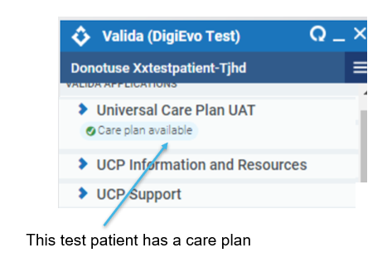
Getting access to a UCP
Valida is now activated in EMIS or SystmOne. You can now access the UCPs.
Load a patient in EMIS.
After a few seconds, the patient’s name will appear in the header of the Valida client.
Select Urgent Care Plan to launch the patient's care plan to view an existing care plan or start a new one.
You should see the following:
UCP Valida Support Line

Slide 7

Service Support for Implementation
For any queries or more information about configuring the Valida client or registering your smartcard, please contact the UCP Support Team
For more information about the Urgent Care Plan, please visit ucp.onelondon.online
UCP Valida Support Line

